Slide 1

Machine learning Group-2 Say my name
NINU BASHEER
SANJEEV KANDEL
SUPRIYA POLANGARI
VIJAY BHASKAR BONTHU
VYSAKH MOHAN THERATTIL

Slide 2
CONTENTS
Introduction
Objectives
Project Details
Technical Analysis
User Interface
Challenges faced
Future Scope
Conclusion

Slide 3
INTRODUCTION
The project is centered on addressing the challenges of pronouncing the names from various cultural backgrounds accurately, especially in diverse academic environments.
It is crafted to ensure that each student’s name is recognized and pronounced correctly, thereby promoting respect and inclusivity.

Slide 4
objectives
Our project aims to create a website where users can input their names and receive precise phonetics transcriptions along with audio outputs.
Moreover, the result is an improved and extract phonetic transcription accompanied by audio, enhancing the overall user experience by ensuring the accuracy of the name pronunciation.

Slide 5
Project details
The front end is developed using FlaskAPI and Python language.
Backend is done using Python language and SQL Query.
API connects the front end to backend using request and response.
Postgreg is used as our Database.
UI developed using html and Tailwind CSS.

Slide 6
….......CONTINUED PROJECT DETAILS
Libraries G2p and GTTS for phonetic transformation and audio conversion and stores the information in a Postgres database.
The database, structured with tables for the student profiles including student details.
Phonetics saved in pronunciation table whenever the phonetics are saved successfully.

Slide 7
Technical analysis
Technically, the project leverages Flask for the Front-end development, Fast-API for the backend with restful-api architecture so that we have separate systems and can be easily maintained, and we can easily provide this as API service, can be integrated with any backend.
We use postgres as database and sql alchemy as ORM(Object relational mapping) which let us create tables on the file.
We also leverages GTTS for audio, G2p pronouncing spelling, Pypen for splitting the word per pronounciation
Notes:
Hello good afternoon This is Vijay. We will talk about our backend architecture and our approach
We are using restful architecture which help us have a complete disconnect with front end and backend which will be easier to maintain, and can be easily integrated with any language in the future or used as a service for any application.
We use Postgres as our Database and sql alchemy as an ORM to manage our data and store student details and student selection which will help us in our recommendation system based on how many times a particular pronounciation is selected. We display top 3 pronounications for an user if the database as the results.
We used google text to speech for audio and g2p for pronounciation and pyphen to spilt the word .

Slide 8
Technical analysis
Back-End Development:
Primary Language: Python (V3.11.5).
API’s – Fast API, Uvicorn for server
ORM- SQL Alchemy, with Psycopg2 for Postgres
Voice – GTTS
Datatypes enforce - Pydantic
Sounds – G2p, Pypen, Eng-to-ipa
Front-End Development:
Framework: Flask (2.2.2).
Languages: HTML5, Python (V3.11.5), CSS3
Database :
Postgres
Software version Control:
System Used: Git
We use pydantic for strict data validation to decrease manual errors.
Notes:
There are the libraries and frameworks we used for different purposes. our backend primarily focuses on receiving the data We have 2 different Post API’s one to create a record and another to save user selection we use pydantic for strict data validations when receiving the data to these API which helps us to determine the error if its specific to frontend or backend processing. Our backend API also Generates the audio file based on the preferred name. once we have the required data we store it to the Database and responds back to the front end for the display. With that I will be handing to over to our next teammate.

Slide 9
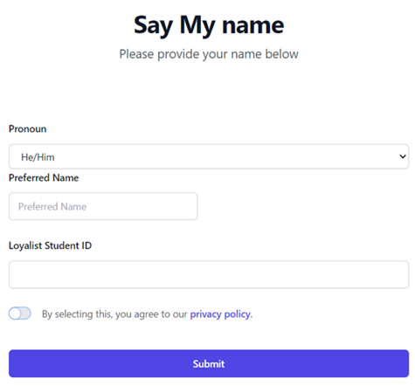
USER INTERFACE

Slide 10
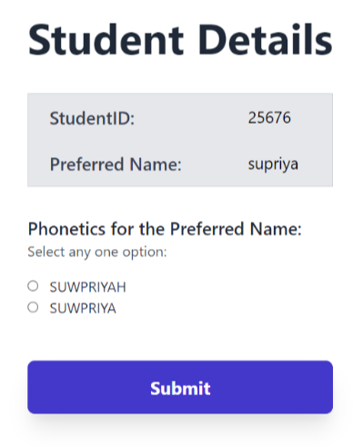
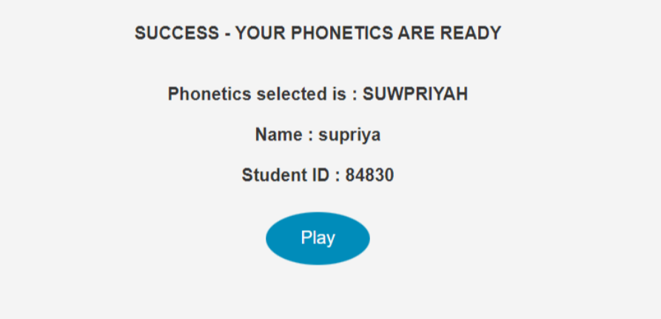
USER INTERFACE

Slide 11
Challenges faced
Our project faced hurdles in generating accurate phonetic sounds for regional names, showcasing the linguistic diversity challenge.
Selecting a suitable library and precisely segmenting words into phonetic components proved challenging, especially for non-English names.
Additionally, discrepancies arose between audio output and phonetic text representation, underscoring the necessity for improved precision in the phonetic representation process.
We faced challenges in connecting the front end and backend using the API calls.

Slide 12
FUTURE SCOPE
Improvement in the precision for the phonetics exploring more libraries.
Adding text box along with phonetics suggestions for inserting the right phonetics by user.
Error handling in the webpages need more improvement .
Adding audio Play button together with phonetic option.
Audio recording option which helps the user record the name.
Can use django for UI in future for more wider scope.

Slide 13
conclusion
Able to addresses the challenges of name pronunciation.
Carefully designed interface and back-end processing helped us to address the objective.
Continuous improvement of the system's accuracy.
Using Flask and Python for front-end development, and Fast-API and Uvicorn for the server.
SQL for Querying the Postgres Database.
The system offers phonetic options, allowing users to select the most accurate representation.
Customized audio play button will help the user to verify the pronunciation.
More and more users added to the DB increases the chance of giving more suggestions for the users.

Slide 14
THANK YOU

